Slide 1

MOOCs – The Future Is Getting Clearer
Charles Severance
International NCSC ONE Conference 2015
14-April-2015
Notes:
Total students: 363K, paid 3325 1/10 finished 1/100 paid 150K students 1486 books wholesale for my book $3.82

Slide 2
One of these things is not like the others:
www.masteringphysics.com
www.masteringastronomy.com
www.masteringpython.com

Slide 3
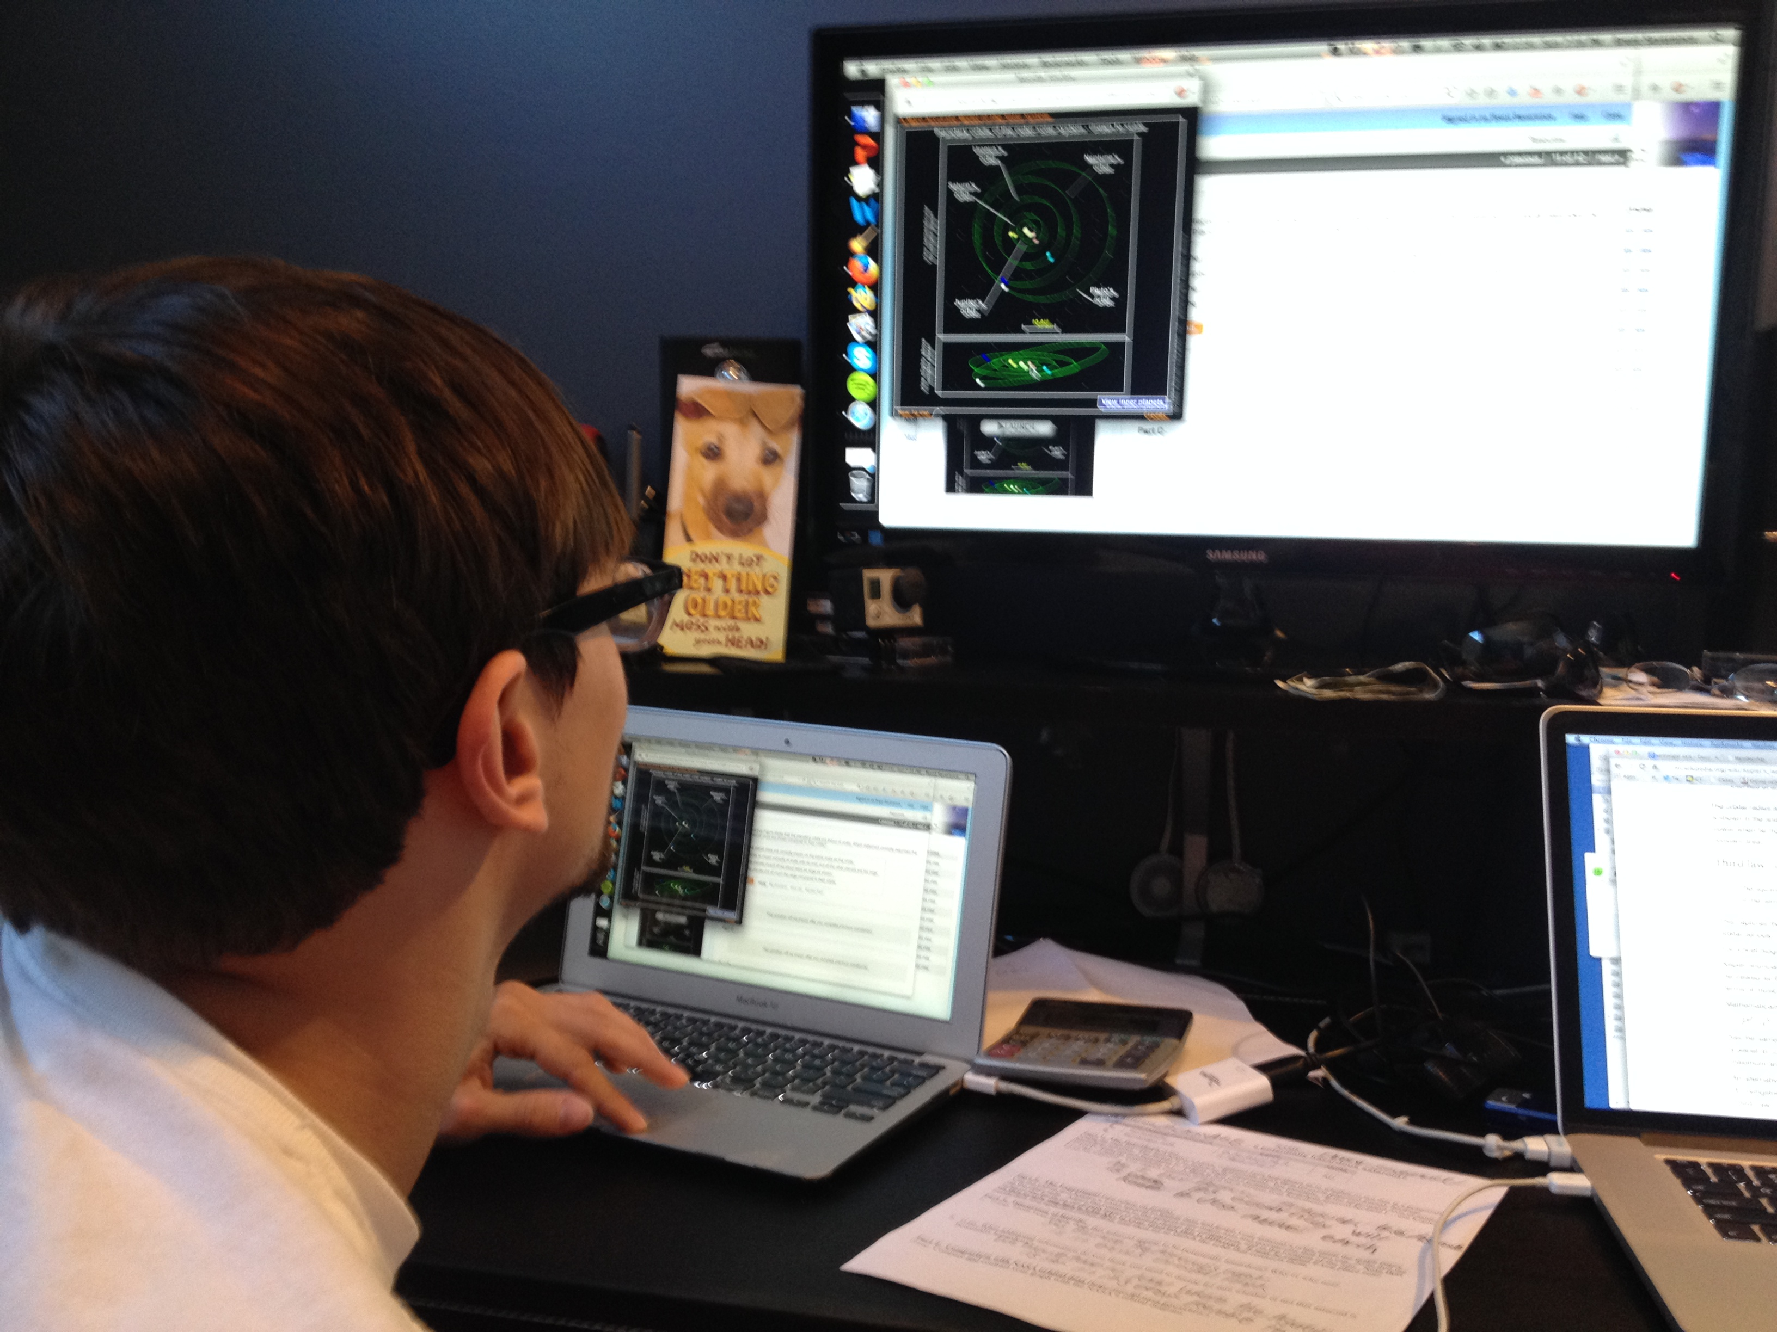

Slide 4
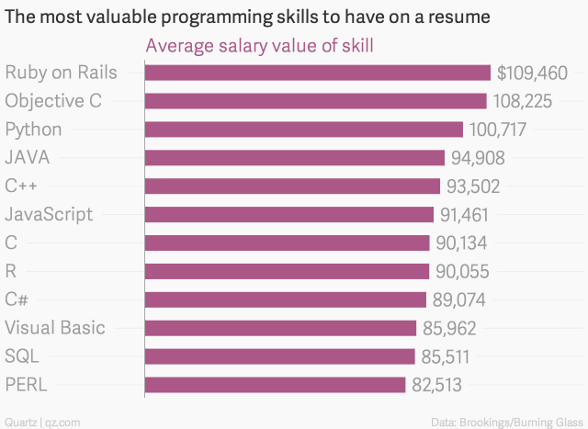
http://qz.com/298635/these-programming-languages-will-earn-you-the-most-money/

Slide 5
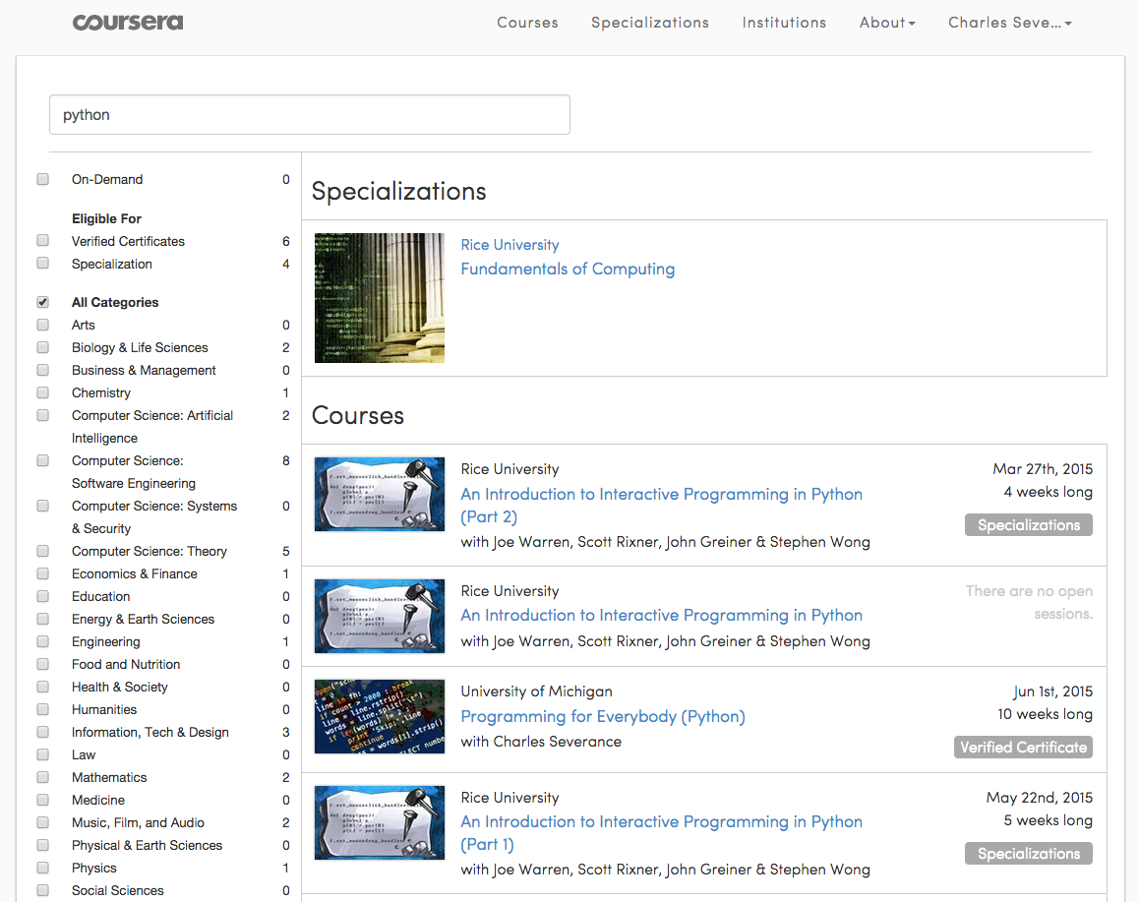
>12 Million Students

Slide 7
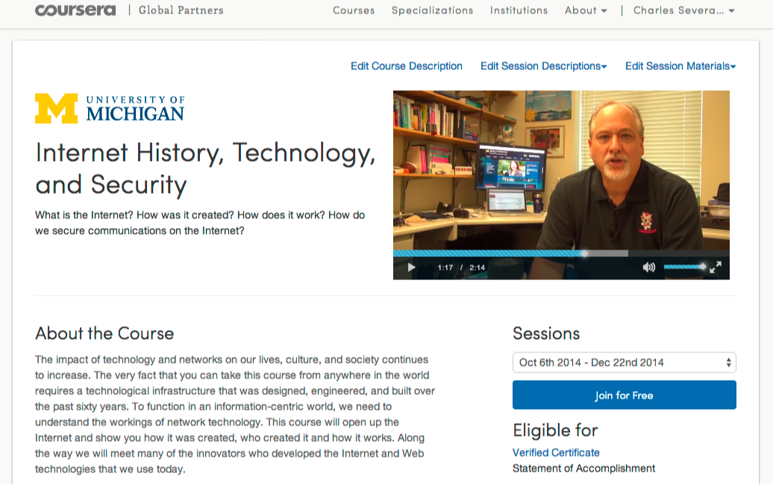

Slide 8
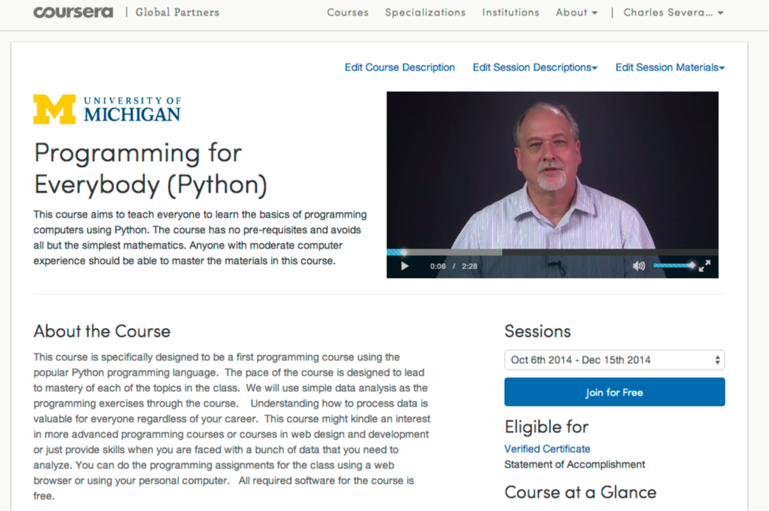

Slide 9
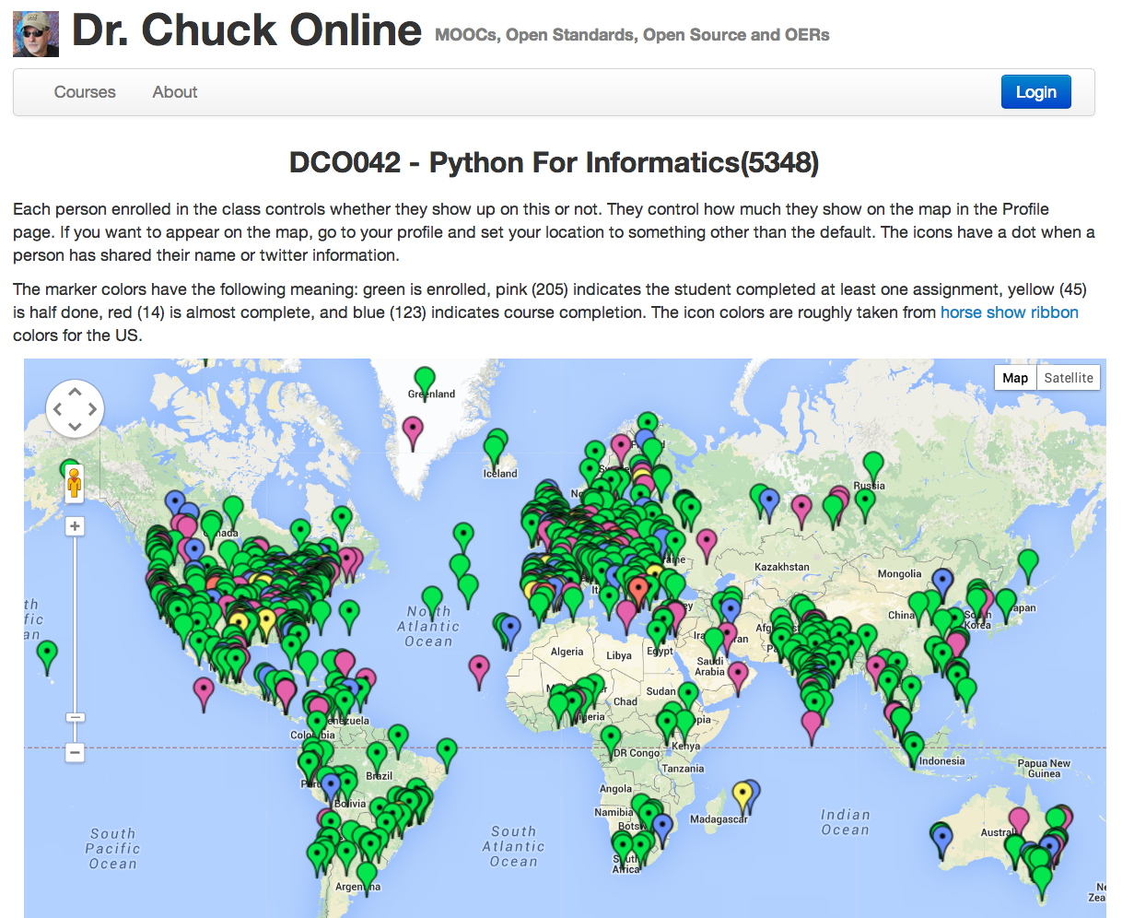

Slide 10
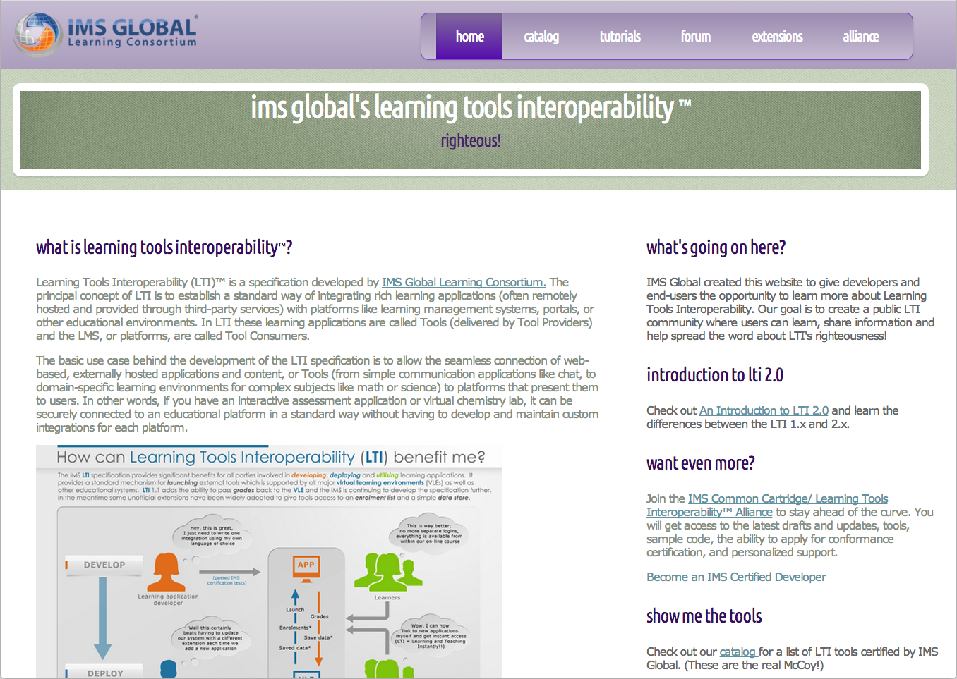
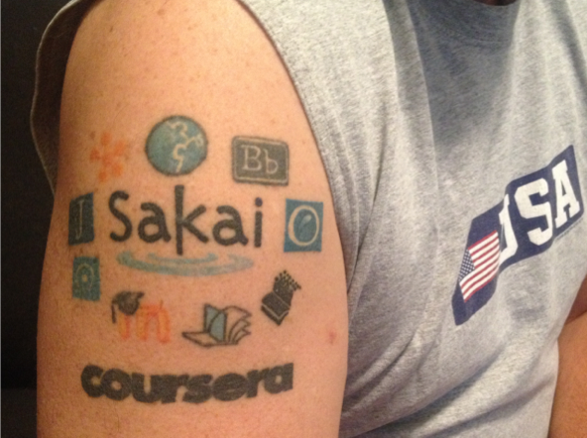
Notes:
Actually I do have a clue... Note Coursera logo.

Slide 11
Game On....
Notes:
What is wrong with this picture??

Slide 12
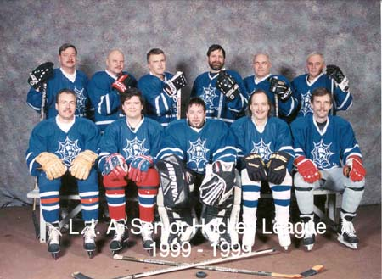
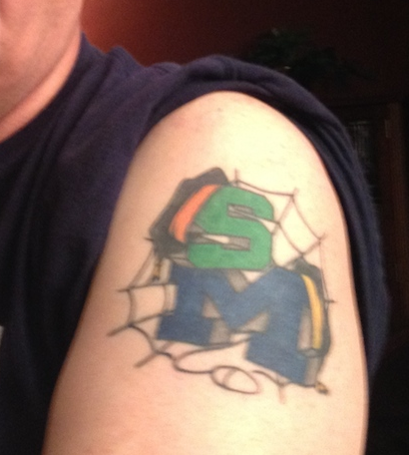

Slide 13
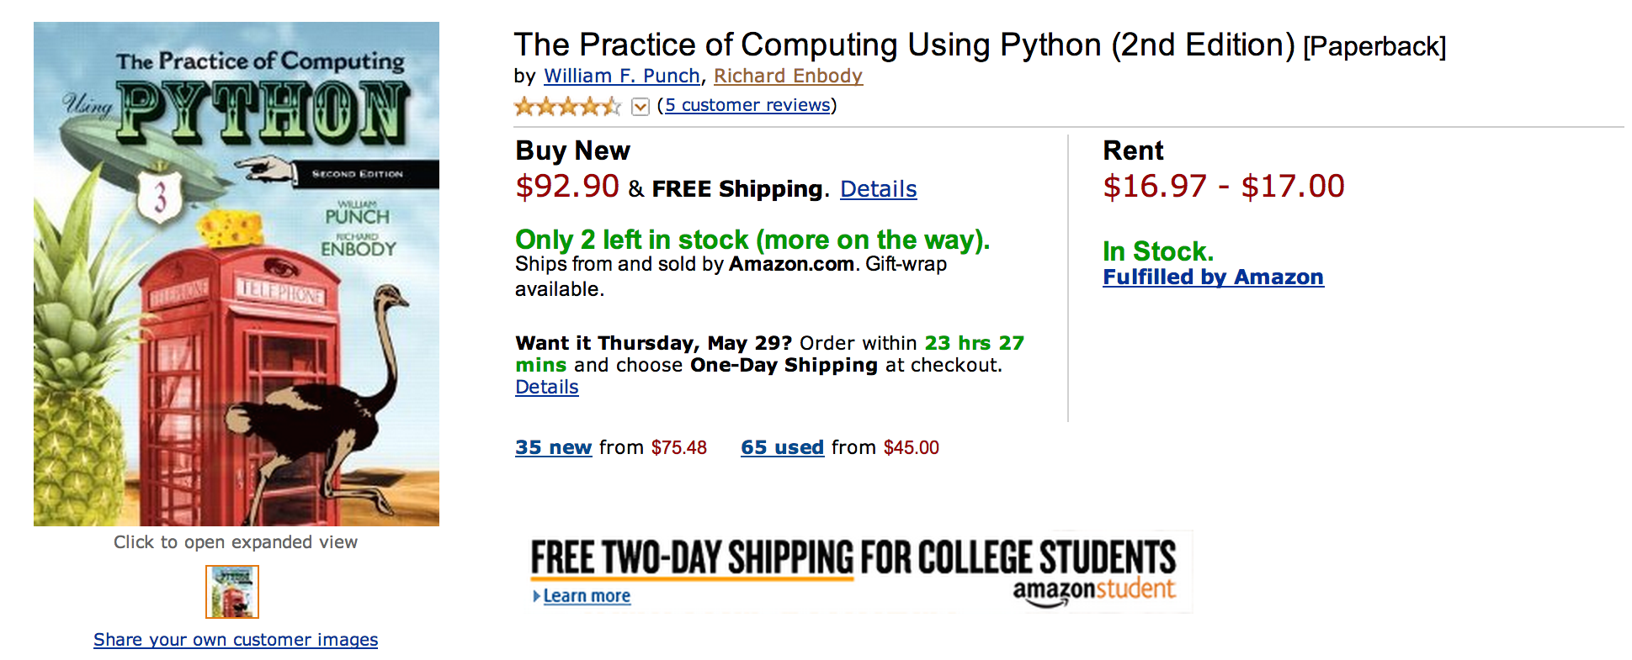
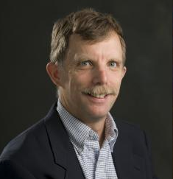
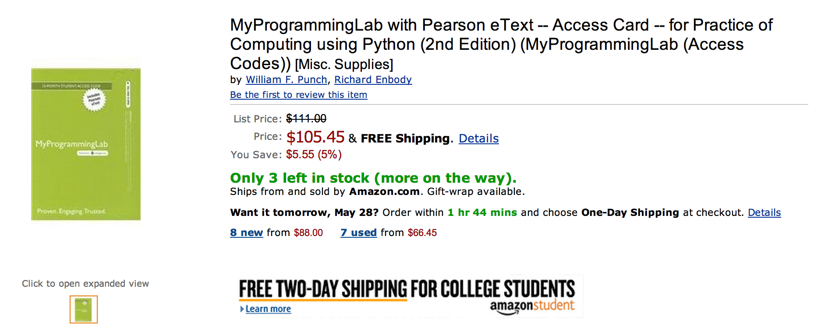

Slide 14
What does $198.35 get you?
Book
Automatic Homework Grading Software
Learning Management System Integration
Instructor Materials
Slides / Solutions Manual / Exams / Course Copy
Instructor Training
3-5 days from notification to full course
Notes:
$65 from Pearson $130 Form bookstore

Slide 15

Teacher Prep
Book
Pearson Value
Proposition
$200
Marketing
Software

Slide 16
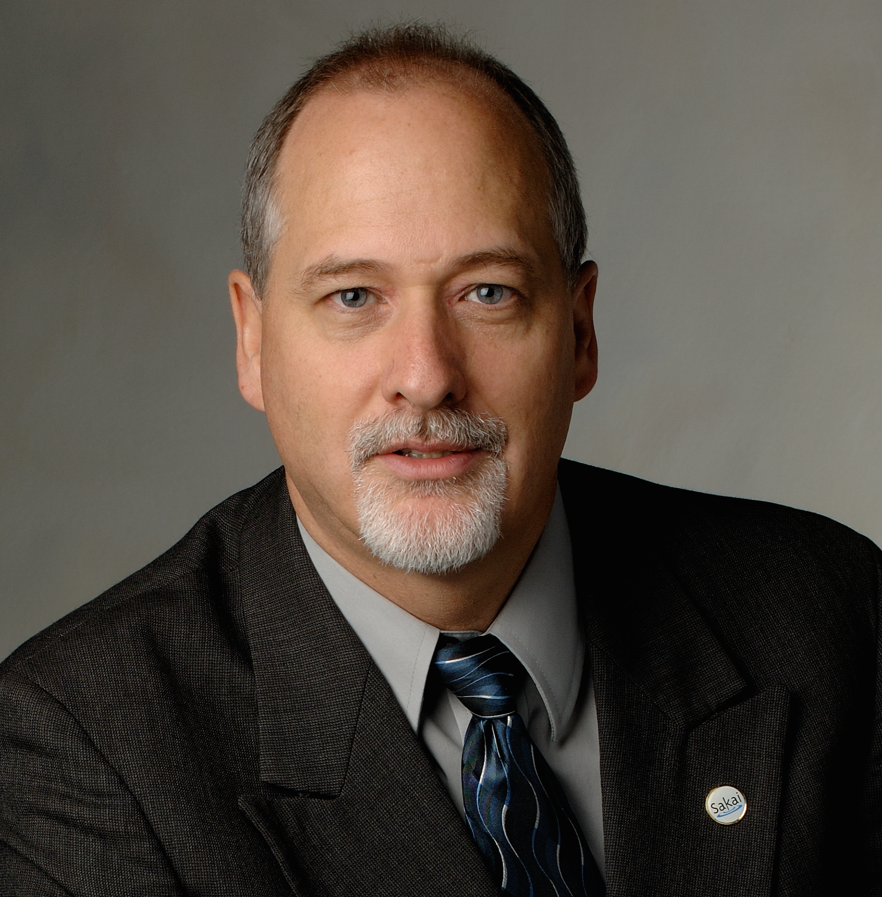
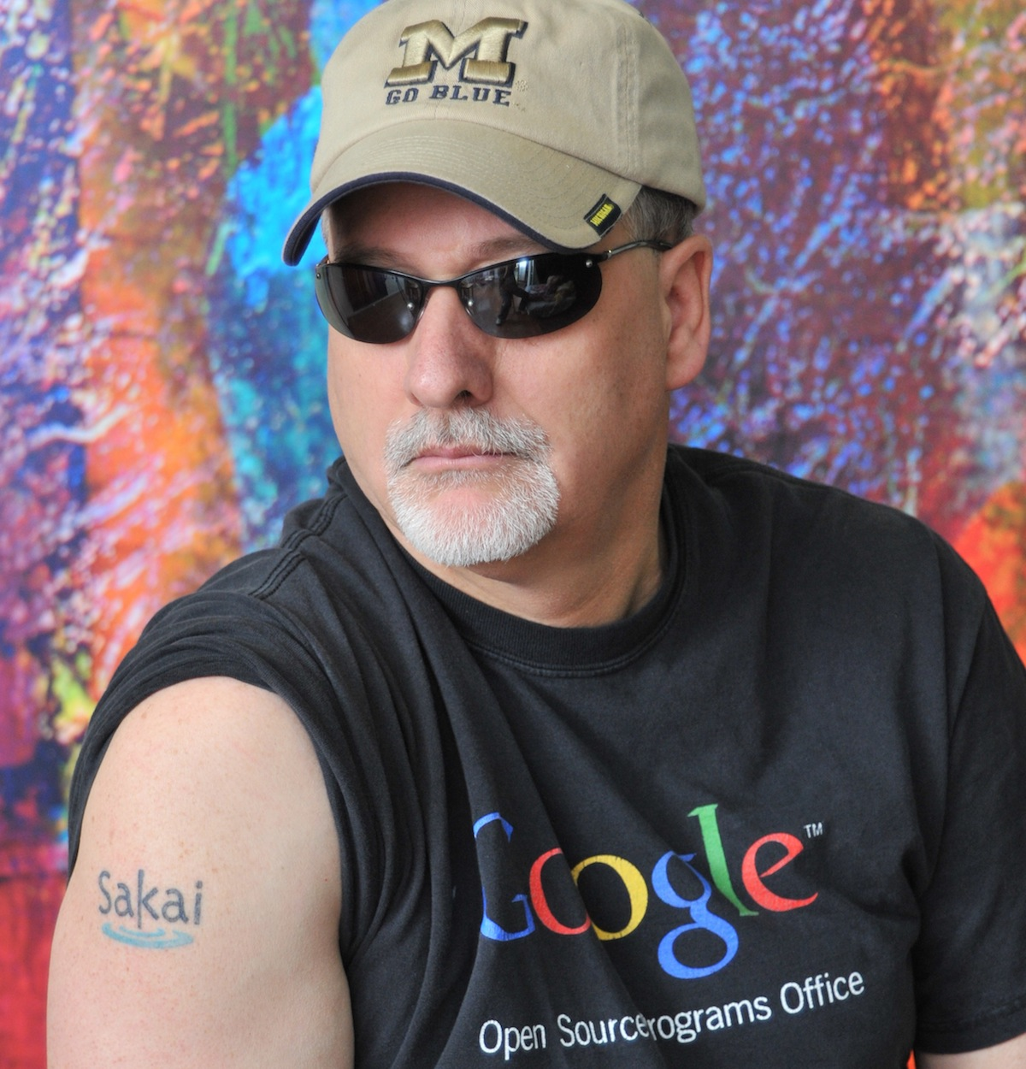
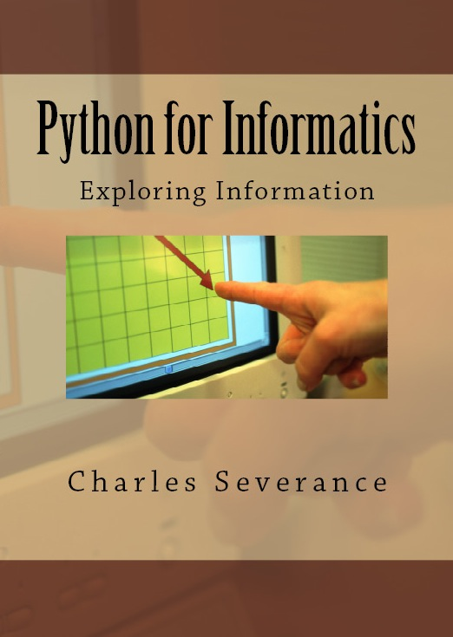



Slide 17
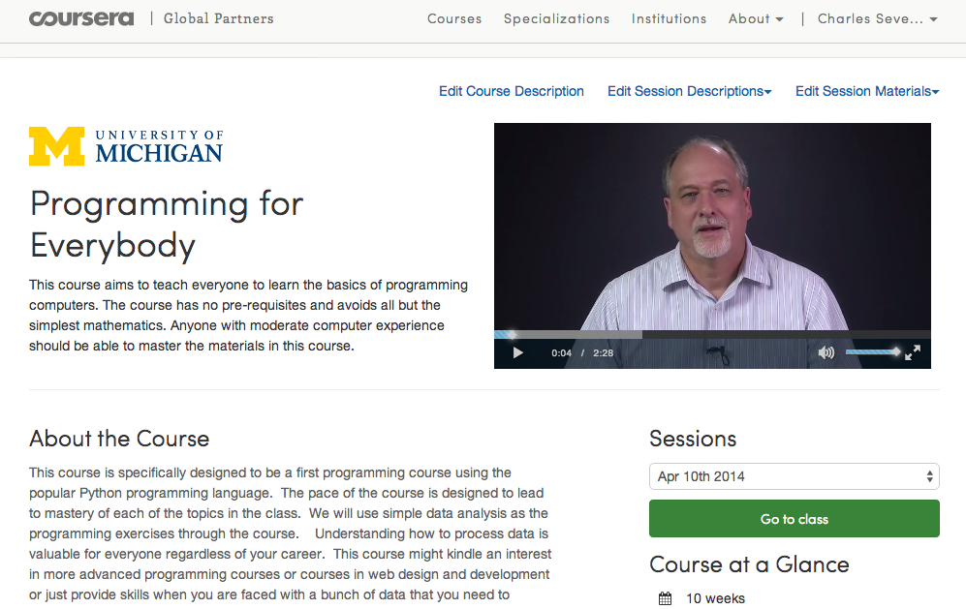

Slide 18
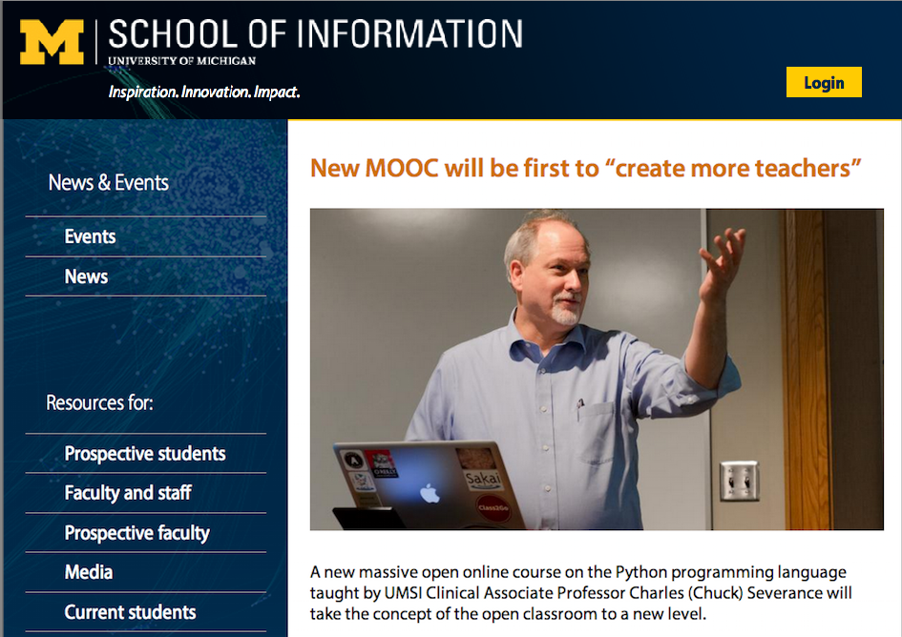

Slide 19
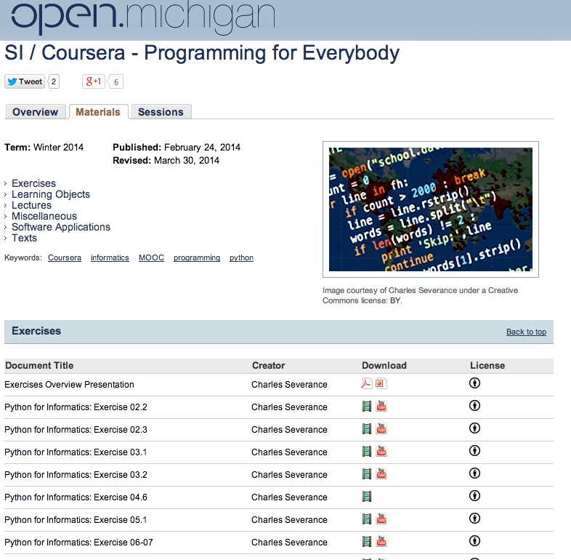

Slide 20
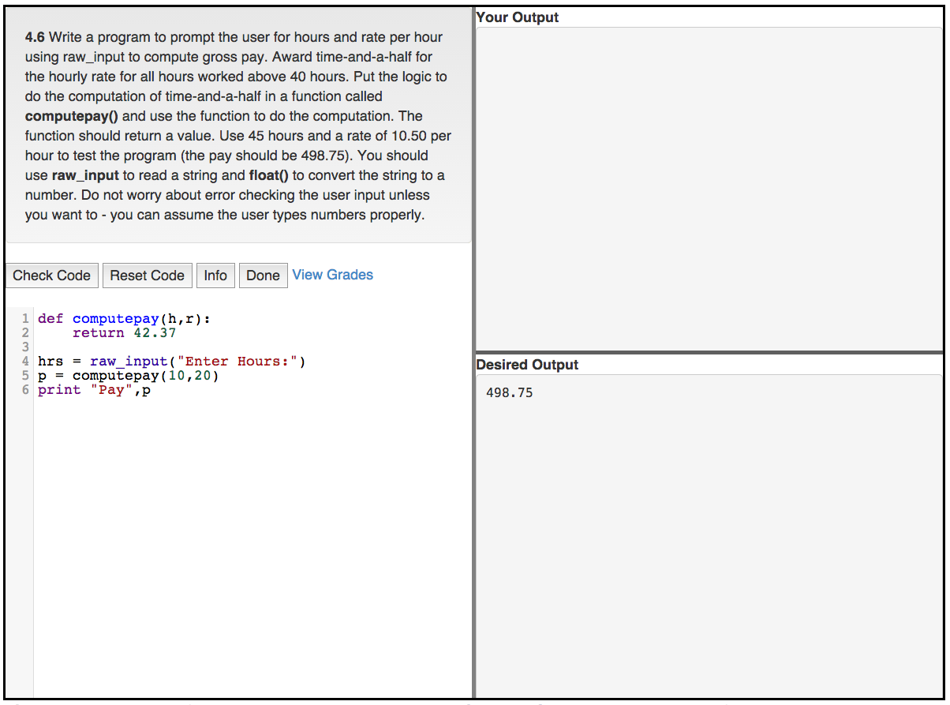

Slide 21
What's Free...
Course Enrollment
Coursera, Dr. Chuck Online, CourseSites, CanvasNet (soon)
Statement of Accomplishment on Coursera
Badge on Dr. Chuck Online
Book: PDF, MOBI, EPUB, iBooks (CC-BY-NC*)
Lecture Slides in editable form (CC-BY)
Lecture Videos in MP4 or YouTube (CC-BY)
Auto-Grader software integrated into any LMS
* I will remove NC for a legitimate translation

Slide 22
Teacher Prep
Book
Value
Proposition
Software
Free (or $9)
Marketing
Community
Notes:
Will I get

Slide 23
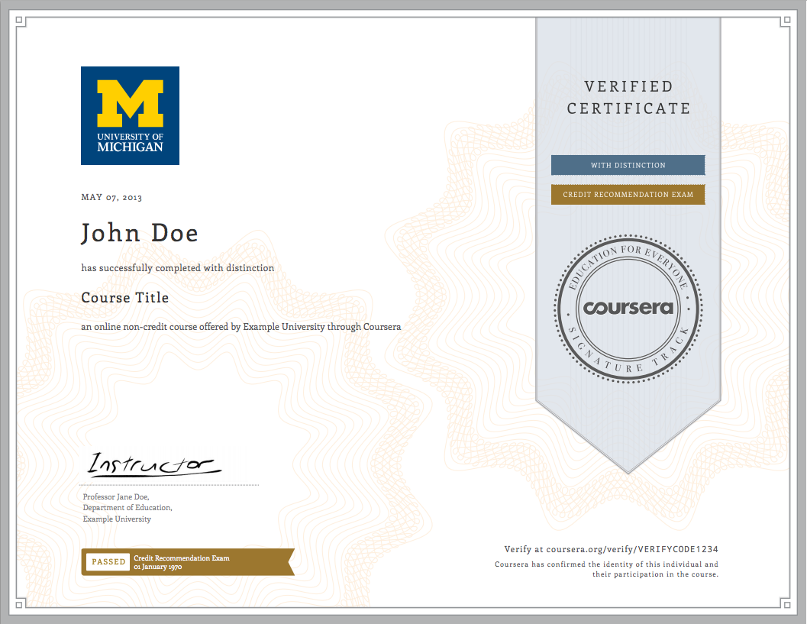
Revenue Model
Print Textbook ($8.99)
Conversion rate 1/200 – Revenue $2.50
Verified Certificates ($40.00)
Conversion rate 1/100 – Revenue $2.00

Slide 24
562,767 Total Enrollment
> 350K Revenue
27K Certs in 2014

Slide 25
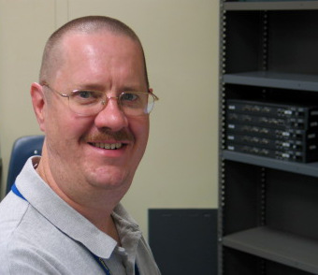
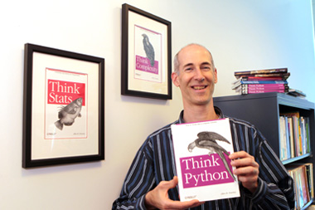
A Free Book
www.pythonlearn.com

Slide 27
Other benefits of Freely licensed content

Slide 28
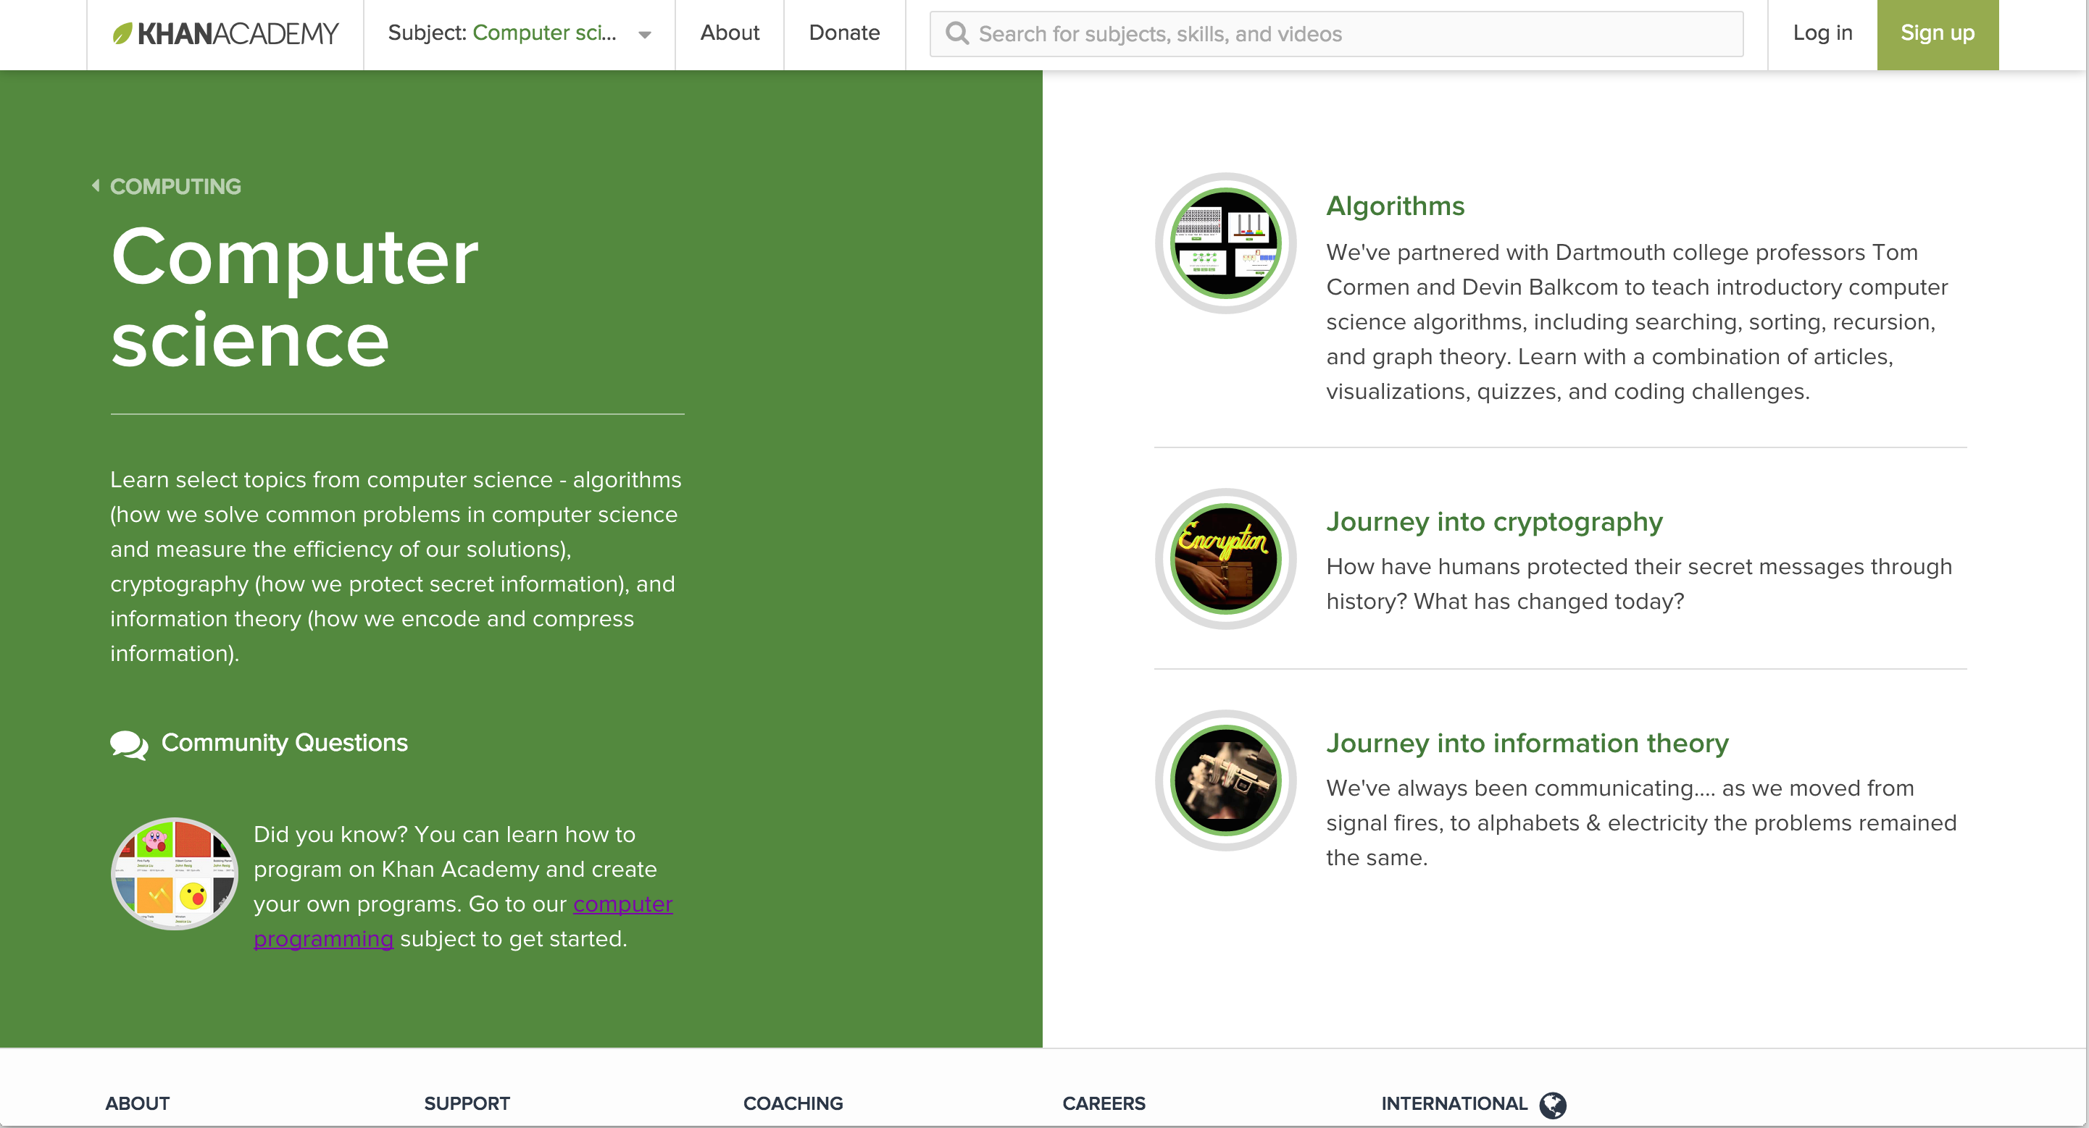

Slide 29
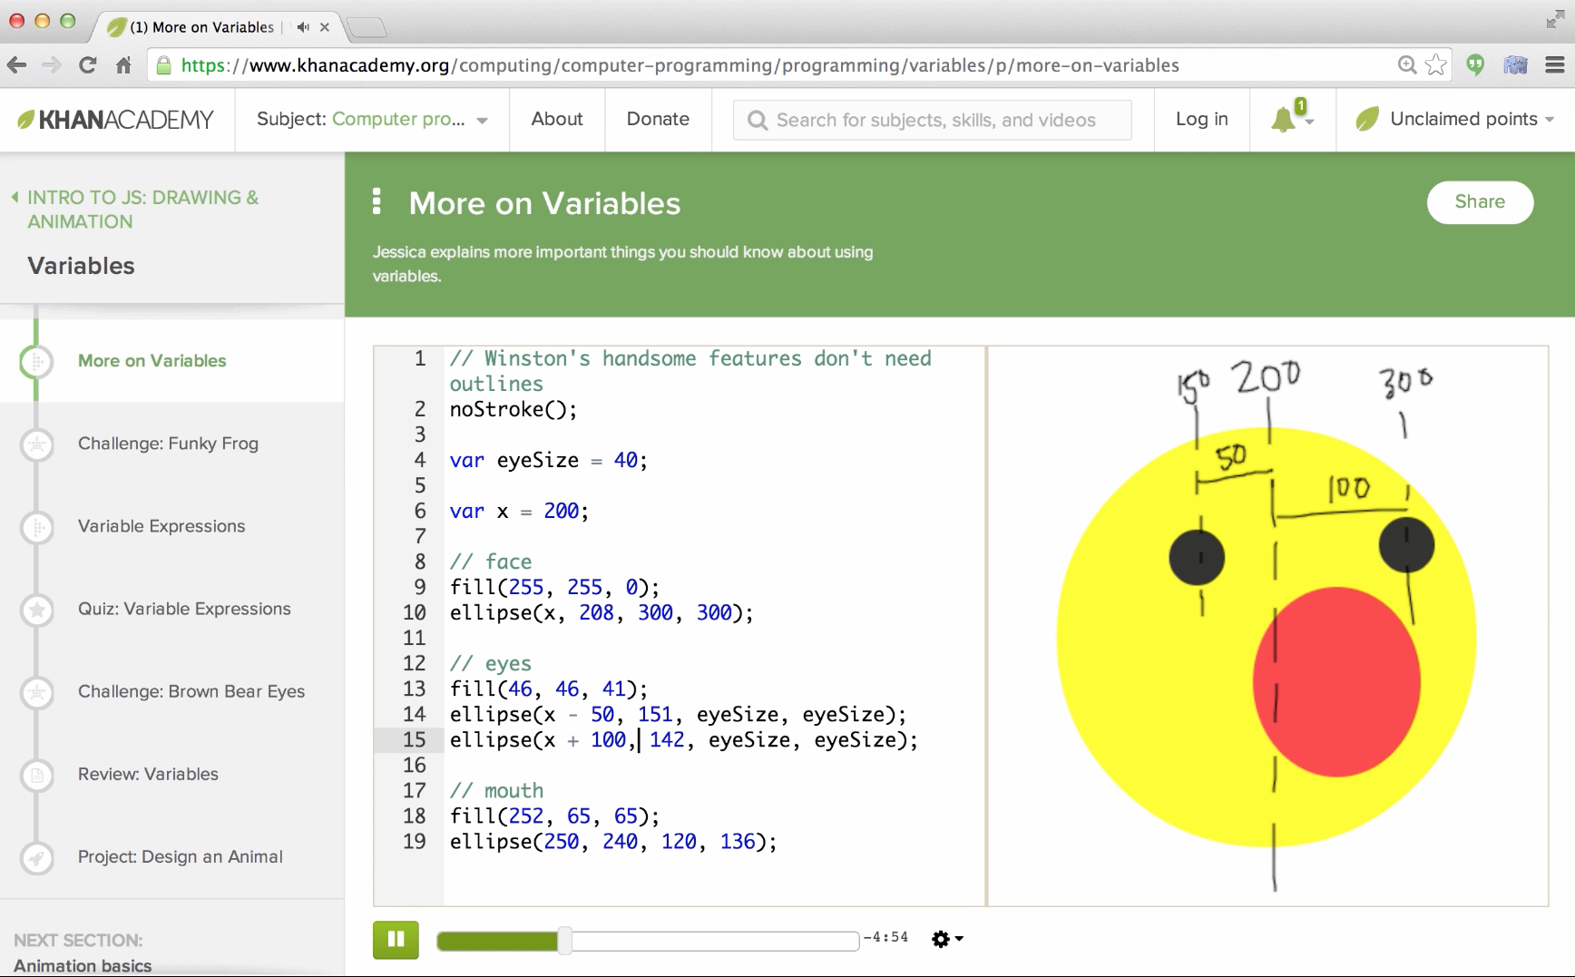
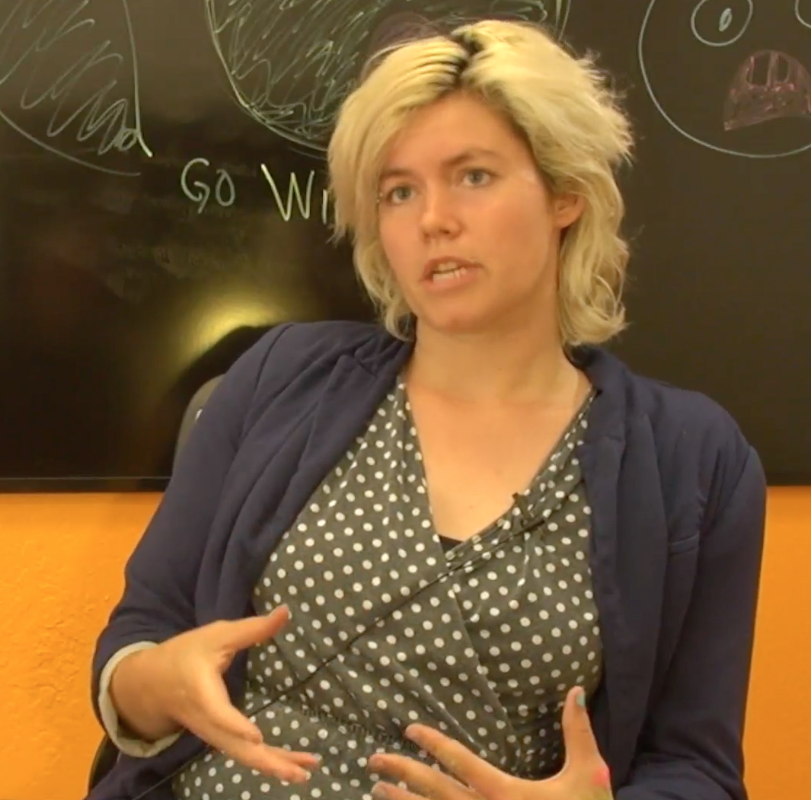
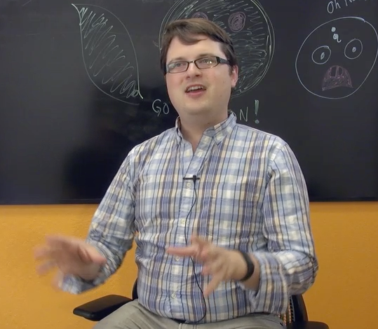
https://www.youtube.com/watch?v=veQaSgjQO2E
Pamela
Fox
John
Resig

Slide 30
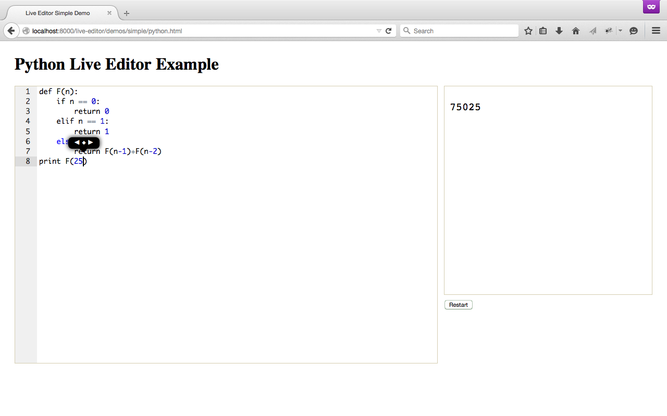
Work In Progress

Slide 31
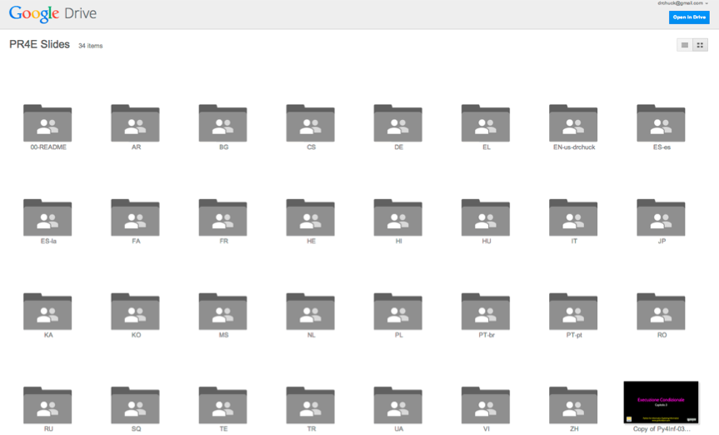
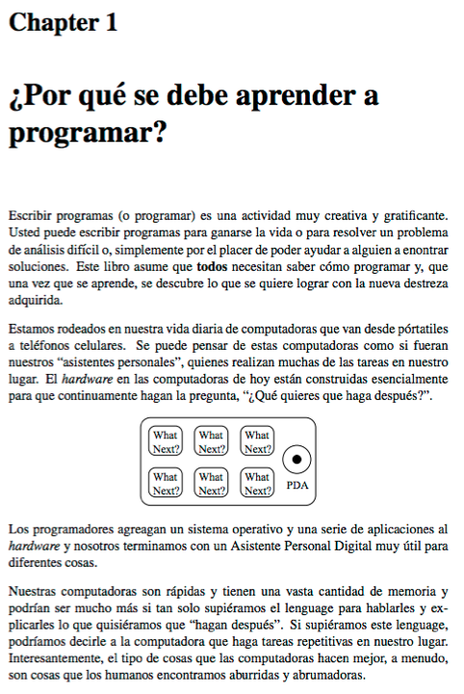
Free Translations
slides.pr4e.org
translate.pr4e.org

Slide 32
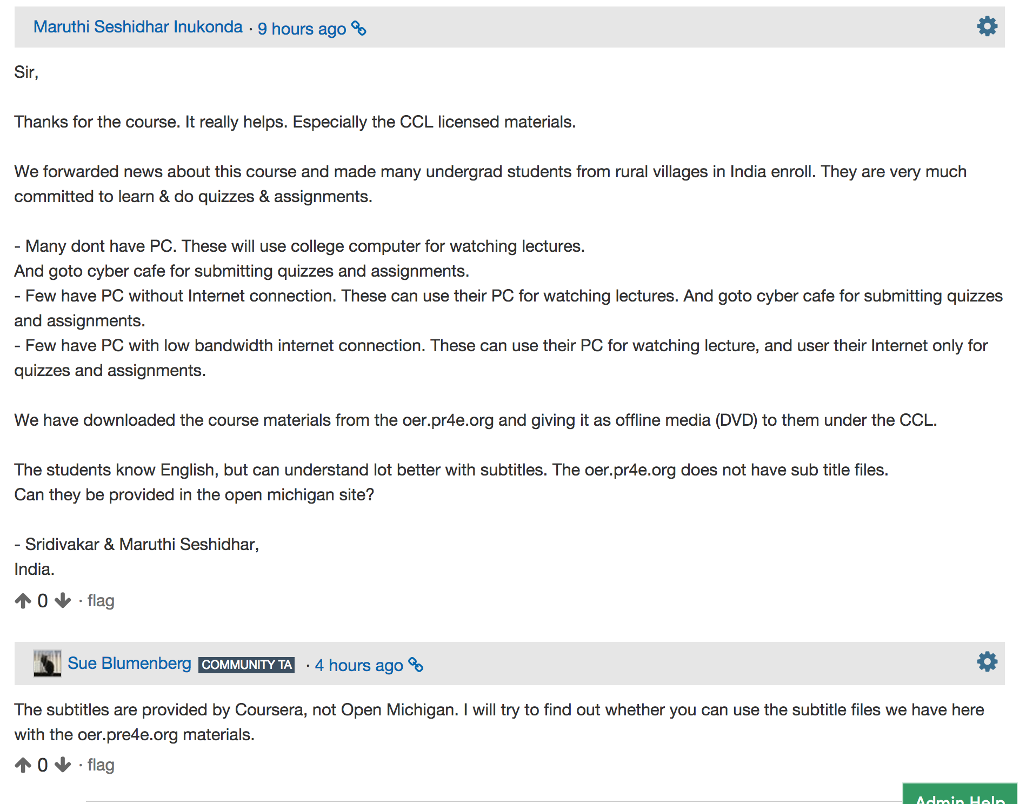

Slide 33
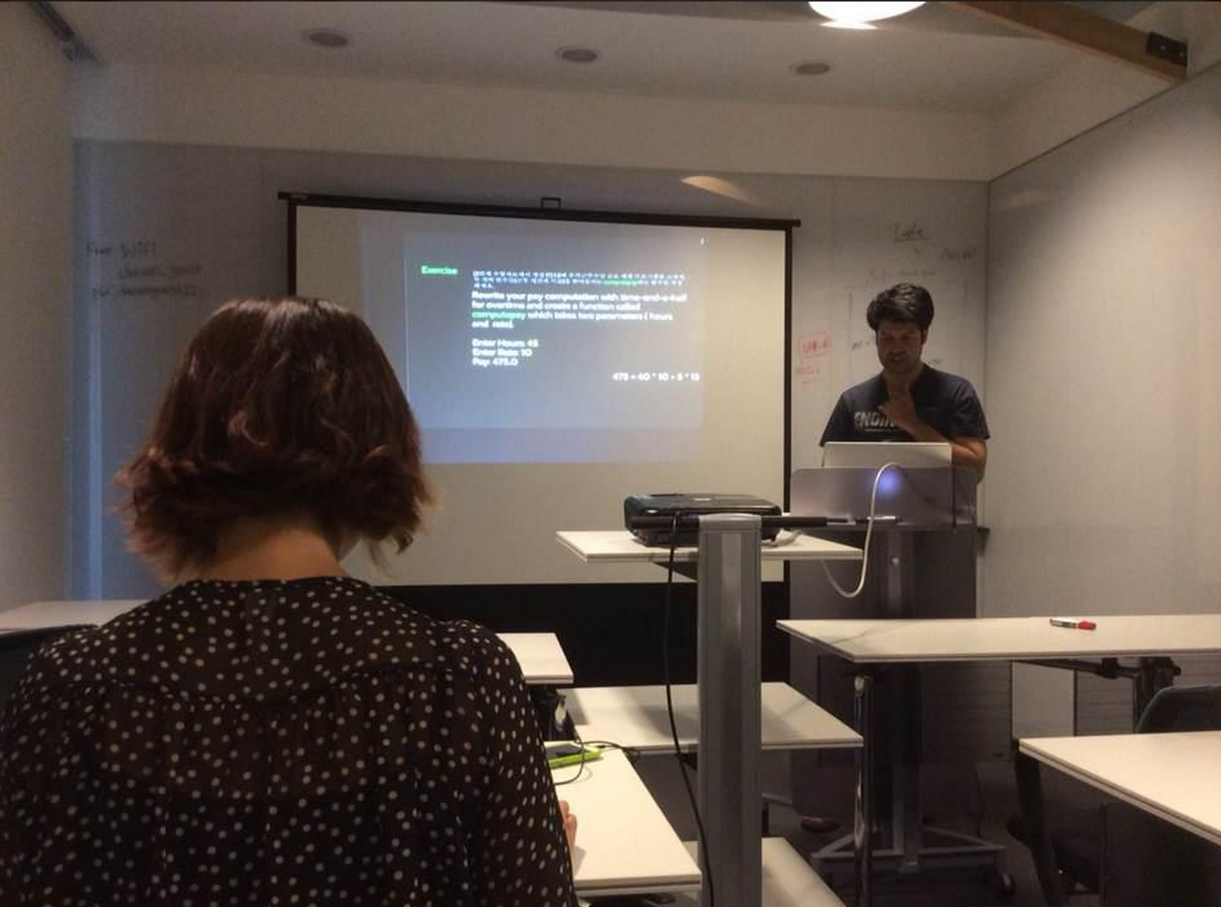
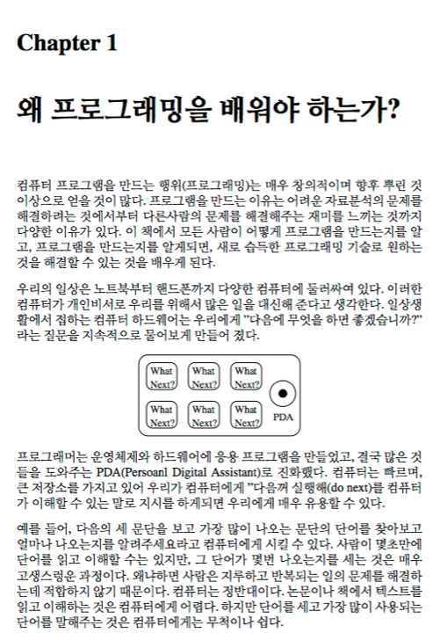
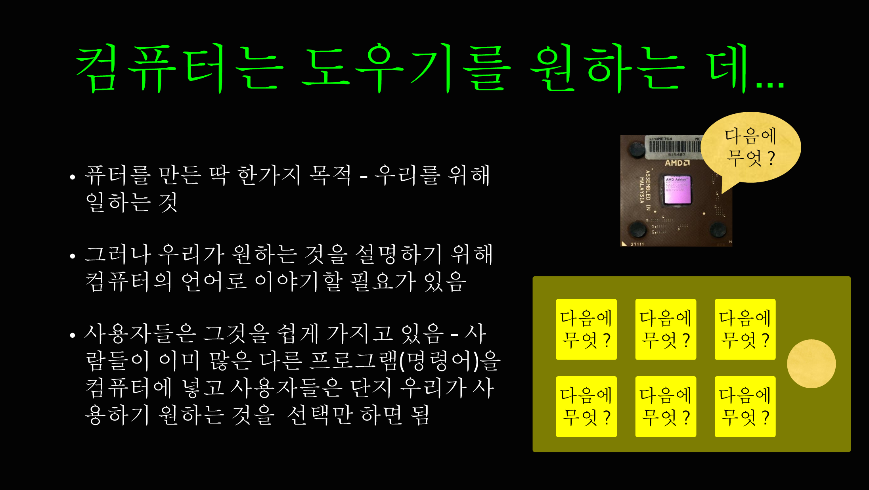


Slide 34
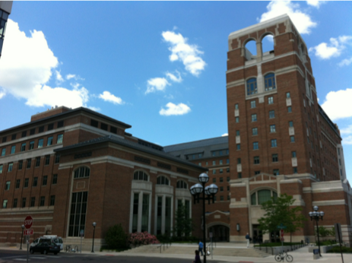
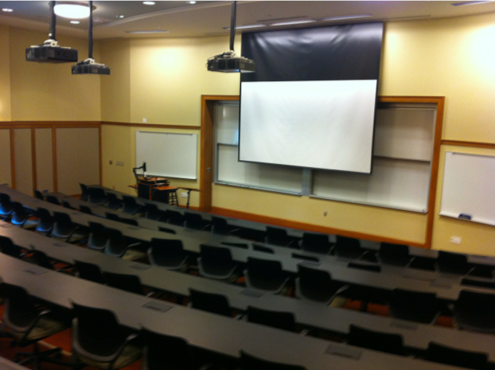
2455 North Quad
North Quad
University of Michigan
Ann Arbor, MI, USA

Slide 35
Looking at Data

Slide 36
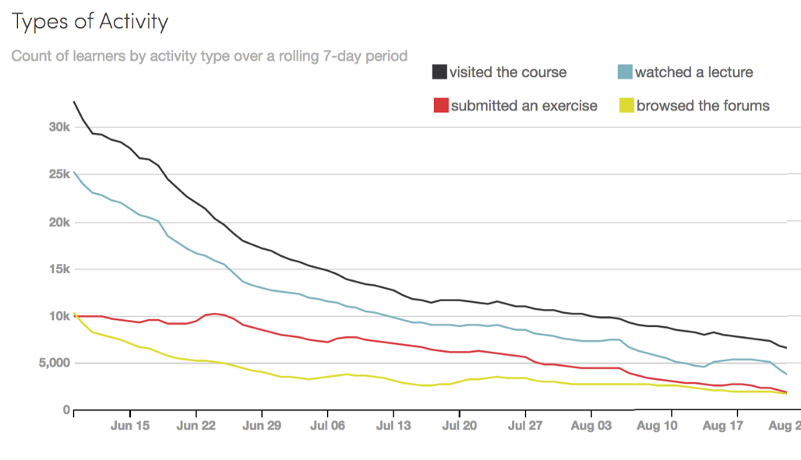
PR4E#002

Slide 37
Start of Registration to Class End
PR4E#002

Slide 38
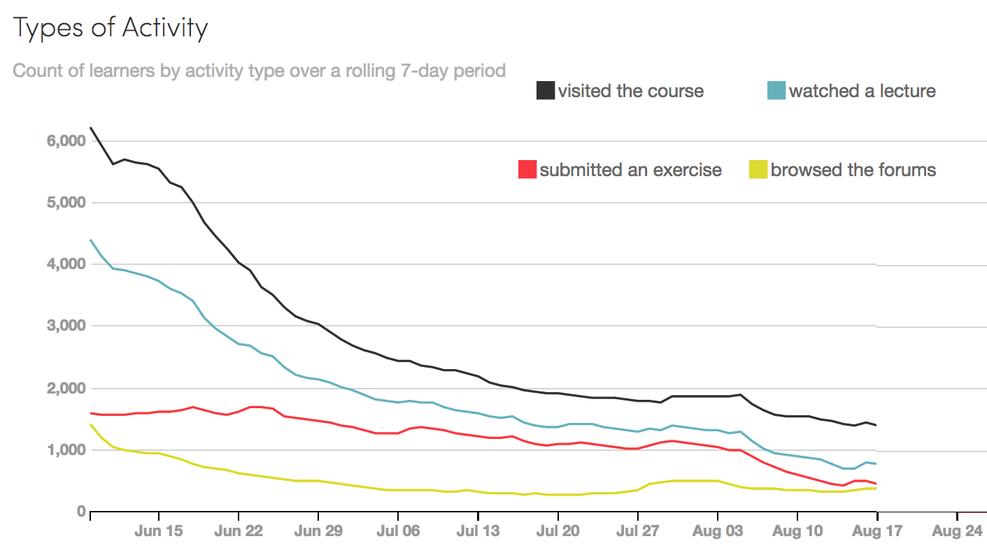
IHTS#006

Slide 39
IHTS#006

Slide 40
Advantages of Scheduled MOOCs
F2F structure maps nicely to MOOC
All students are working on the same homework they can help each other
You get time off between semesters to rework things

Slide 41
Problems With Scheduled MOOCs
Changing dates throughout a class for a new semester is no fun
No good way to test software between classes so first week is always a bit crazy
Students want extensions for extenuating circumstances
Many students know the material and just want the certificate – always asking to go faster
If you make a mistake you need to extend the schedule
Closing down a course for certificate award takes 1-2 days

Slide 42
Self-Paced Technical Issues
Streaming / Social Peer-Grading
Contextualized help by time/topic
Discussion board posts can't last forever – subtle
Schedule allows restart
Content needs so be pretty clean
Schedule allows focus and limits risk
Need a self-sustaining community / culture
Can you ever take time off?
What is the role of the teacher?
Schedule avoids the need to be everywhere at the same time?

Slide 43
Lead Community Teaching Assistants
Sue (CA)
Mazen (Egypt)
Mauro (Italy)
voices.dr-chuck.com

Slide 44
New York, Los Angeles, Ann Arbor, Chicago, Washington DC, Memphis, Seattle, Seoul, Barcelona, London, Mexico City, Amsterdam, Manila Melbourne, Perth...
office-hours.dr-chuck.com
Notes:
Since I have a very active travel schedule, I decided to hold office hours in the major cities I have visited in the past 18 months. I have held office hours in over 15 cities and in each location somewhere between two and 15 students show up.

Slide 45
But when SELF PACED works...

Slide 46
Why not Self Paced Right Away?

Slide 47
Course Development by Semesters
(1) Pick book, develop slides and assignments
(2) Fine tune materials from (1)
(3) Build auto grader, record lectures, mini-flip
(4) Write 250-page book, refine materials
(5) Teach scheduled MOOC
(6) Convert MOOC to self-paced

Slide 48
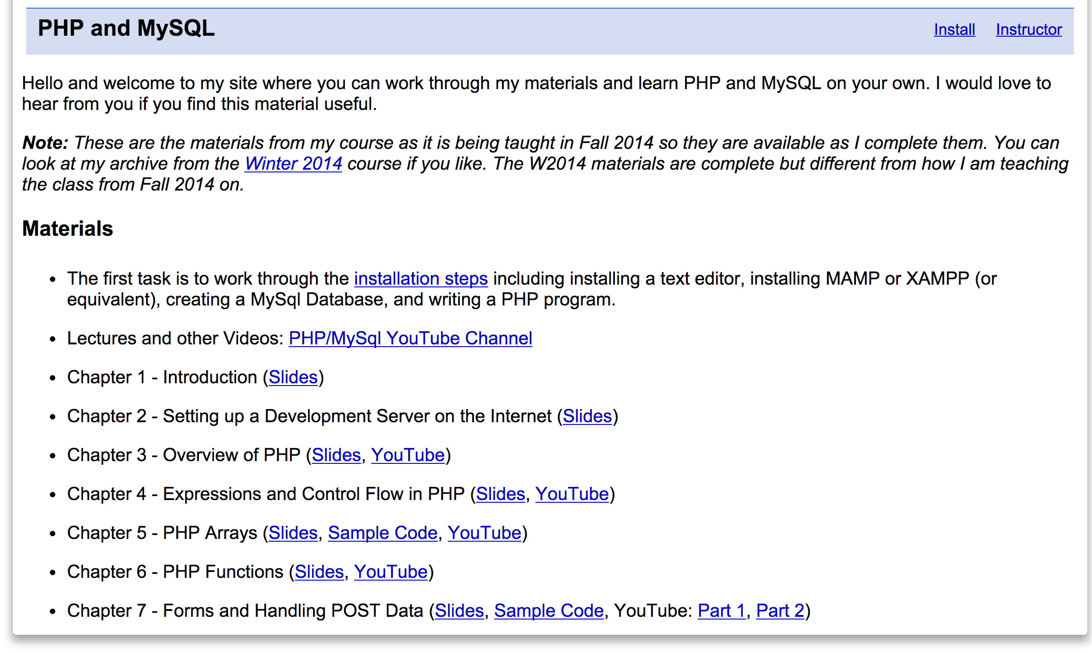
www.php-intro.com

Slide 49
Beyond Self Paced...

Slide 50
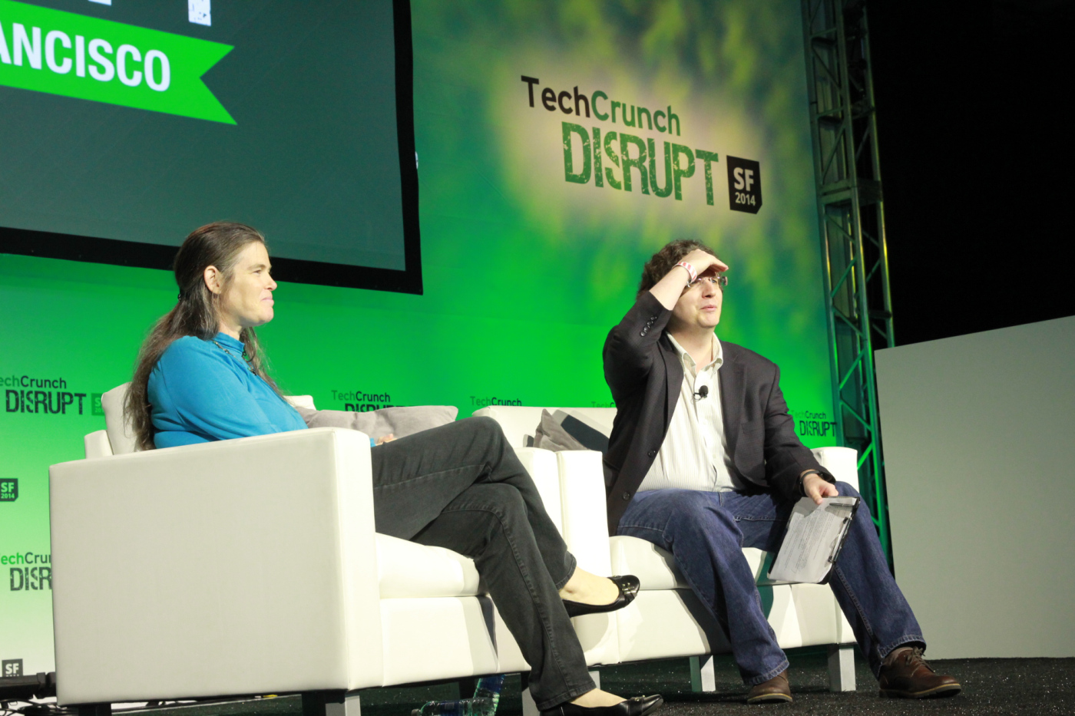
This morning at Disrupt SF, Coursera’s president Daphne Koller pushed back against the notion that her company is a for-profit education company: In her view, Coursera is instead a for-profit technology company.
http://techcrunch.com/2014/09/10/coursera-president-daphne-koller-2014-is-the-year-moocs-will-come-of-age/

Slide 51
Questions...

